Slide 1
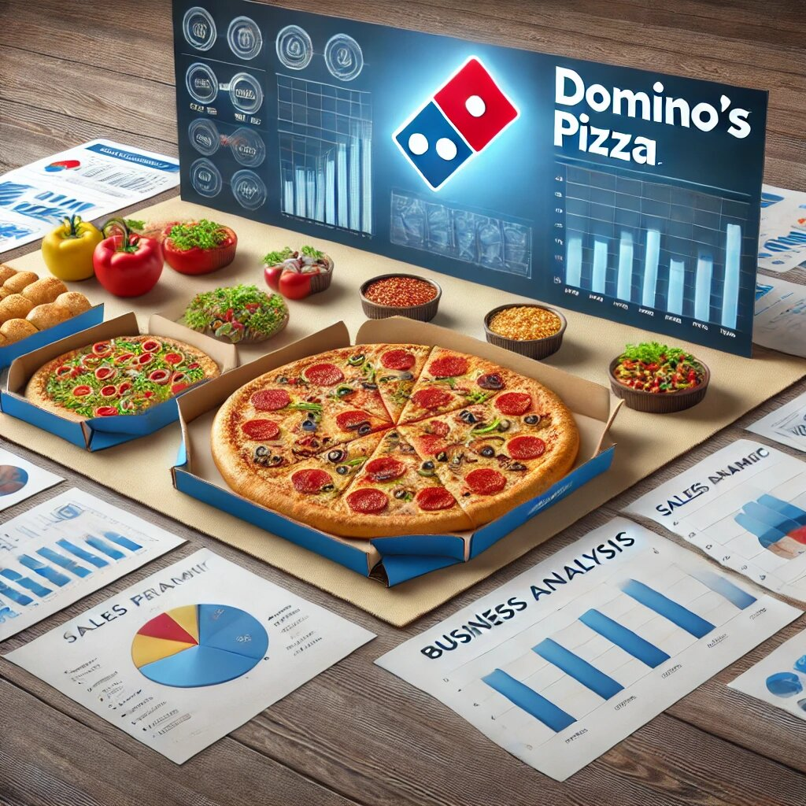
Sales Performance Analysis and Visualization
Created By –Ayush Donga

Slide 2
CONTENT
Company Overview
Problem Statement
Data Request and Tools
Analysis on Domino’s sales insights

Slide 3

COMPANY OVERVIEW[DOMINO’S]
Domino's Pizza is a globally recognized pizza delivery chain, known for its fast delivery services and wide variety of pizzas. Established in 1960, Domino's has expanded its presence across multiple countries, offering high-quality pizzas with a customer-centric approach. The company operates in more than 90 countries with thousands of stores globally. Domino's is known for its delicious pizzas, quick delivery service, and customer satisfaction. Domino's Pizza has a process to deliver pizzas within 30 minutes. The brand is renowned for its innovative menu options, consistent taste, and efficient delivery network.

Slide 4


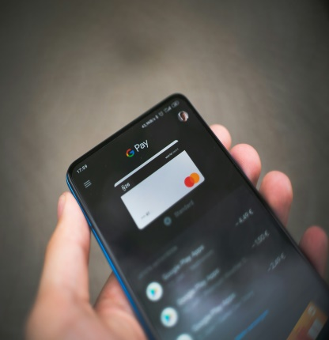
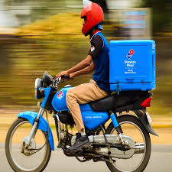
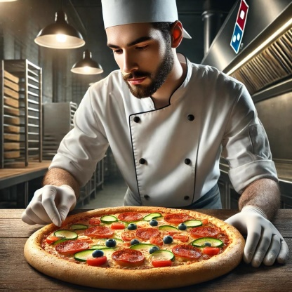
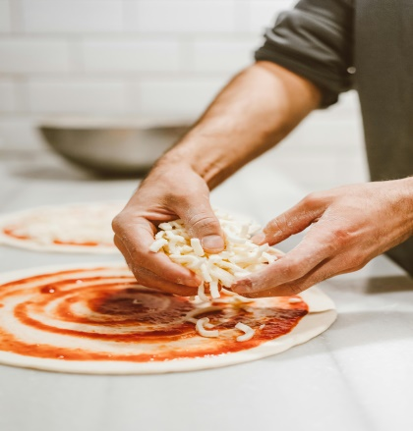
COMPANY OVERVIEW[DOMINO’S]
Place Order By
Customer
Payment Check(if online)
Deliver Pizza To Customer in 30 Minutes
Pizza Dispatch
Pizza Quality Check
Pizza Preparation

Slide 5
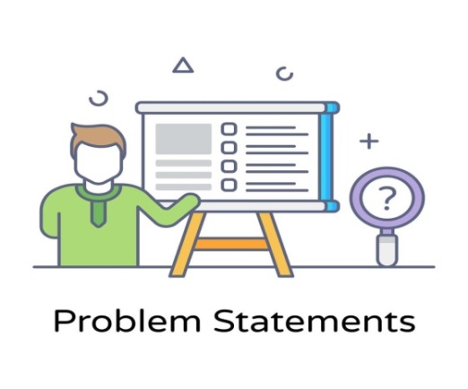

Problem Statement
Domino’s success, management has identified a critical gap in actionable insights in different seasonal trends or different category Sales, which limits their ability to make prompt and data-driven decisions To bridge this gap, they aim to enhance their data analytics capabilities. We have solved these problems by make analysis on this data by using MYSQL and Power BI.

Slide 6

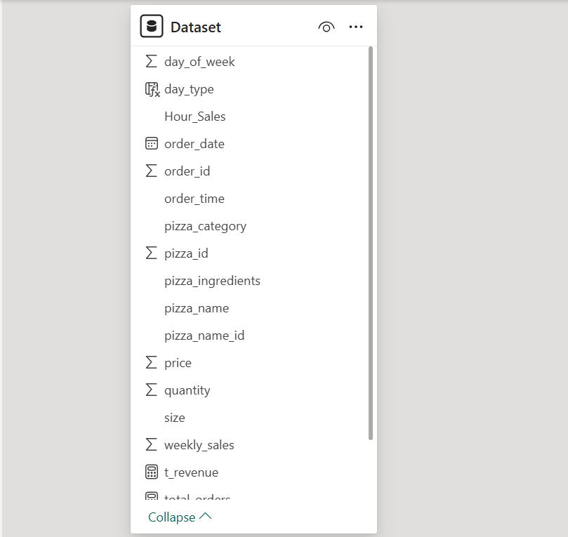
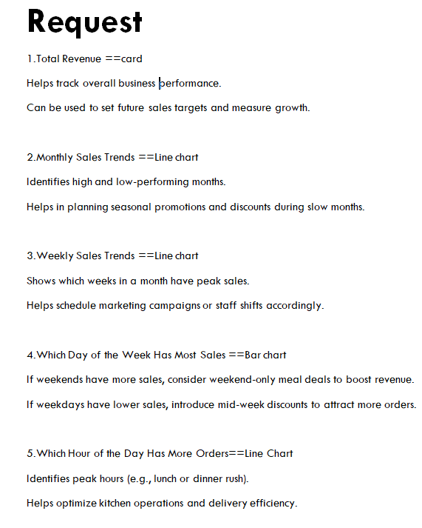
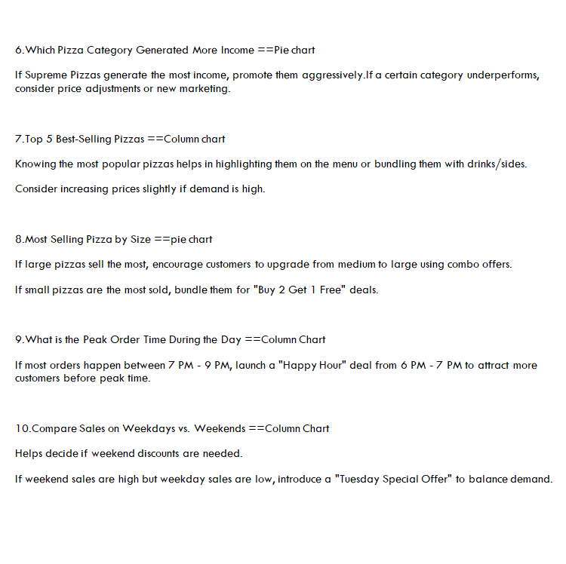
Data Request and Tools

Slide 7
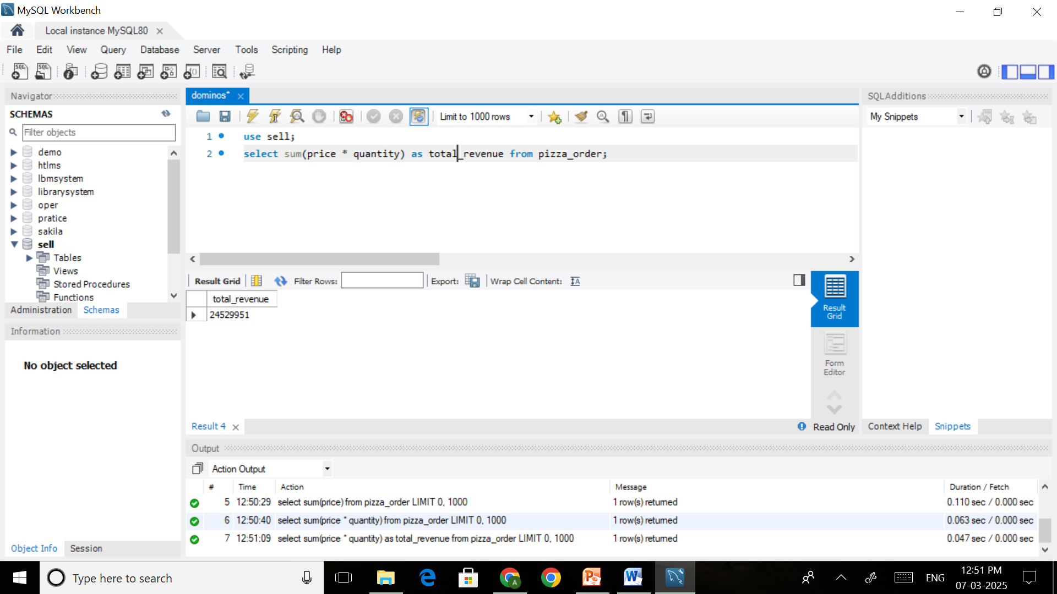
Analysis on Domino’s sales insights
1.What is the total revenue generated from all Pizza Orders?
INSIGHTS : The total Revenue of year 2024 is 24529951(24.54M).

Slide 8
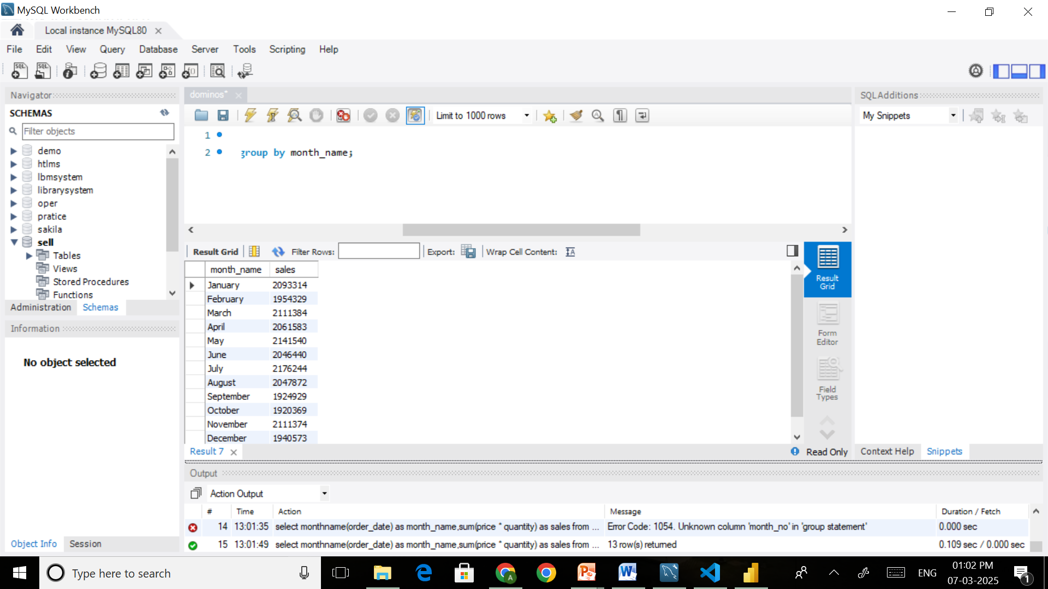
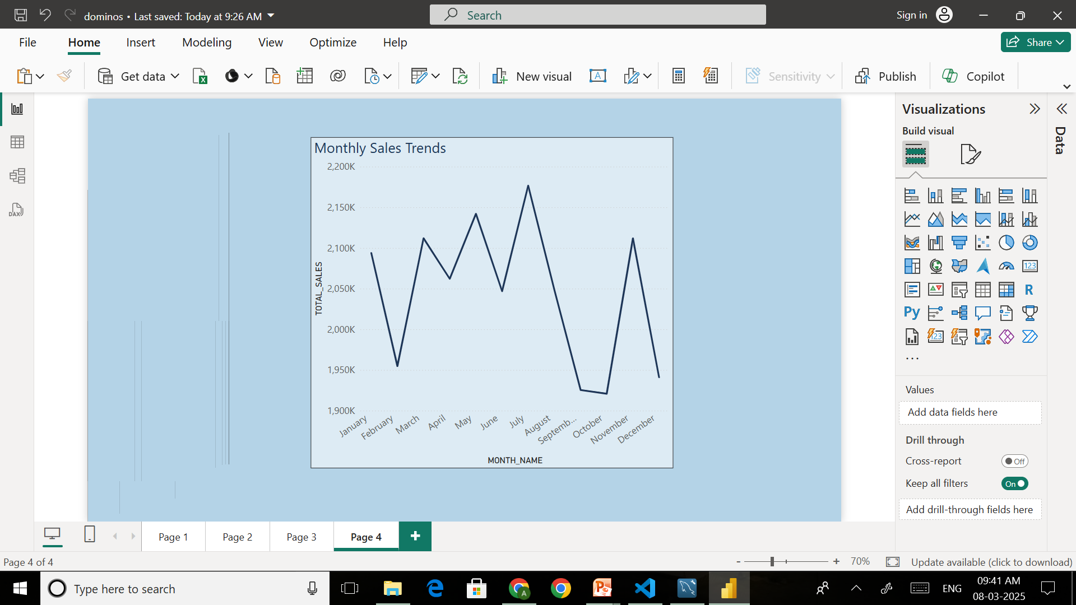
2.What are the Monthly Sales trends for Dominos pizzas?
INSIGHTS : By this analysis and visualization we have get top 2selling months where selling is up to there are July and May. In July sales is 2176244(2.18M) and In May sales is 2141540(2.14M).

Slide 9
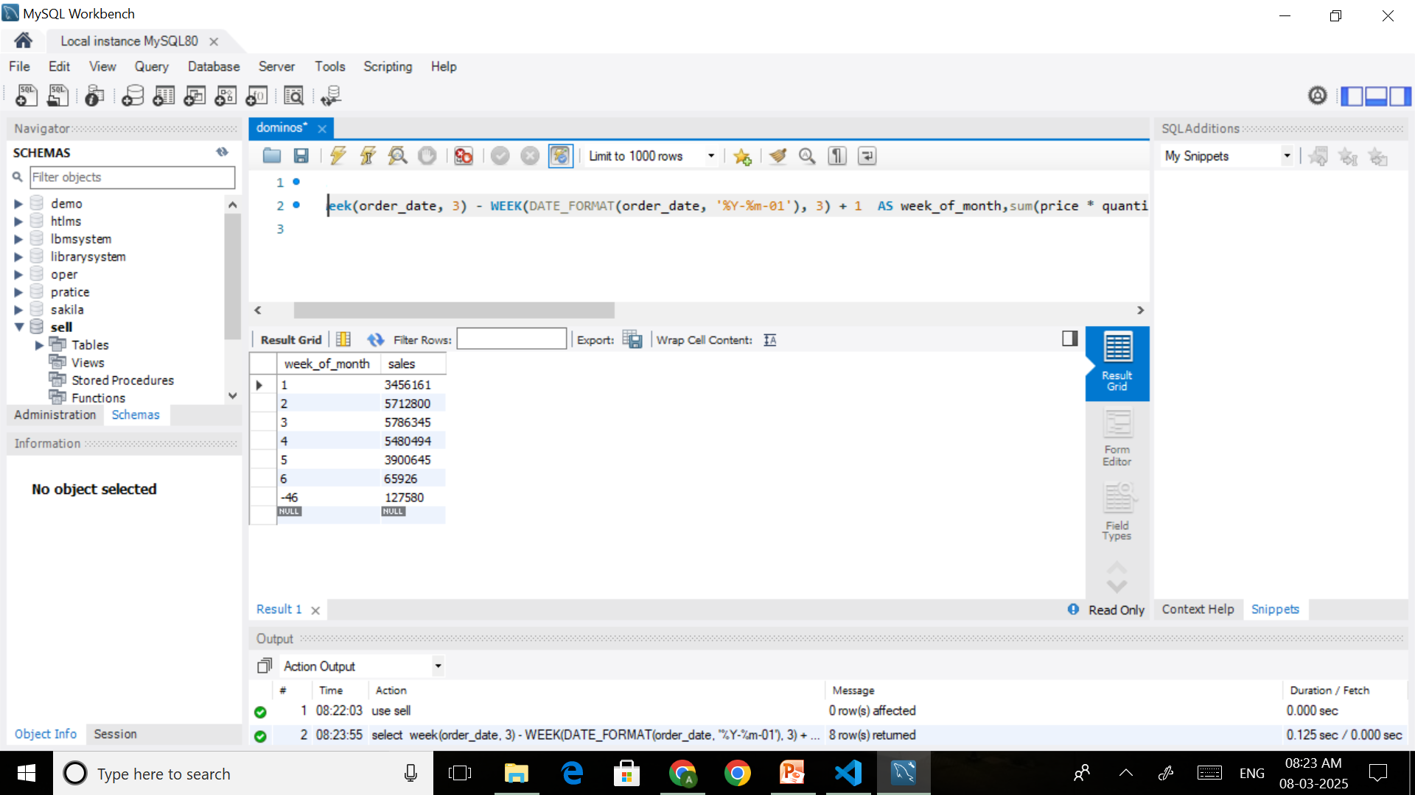
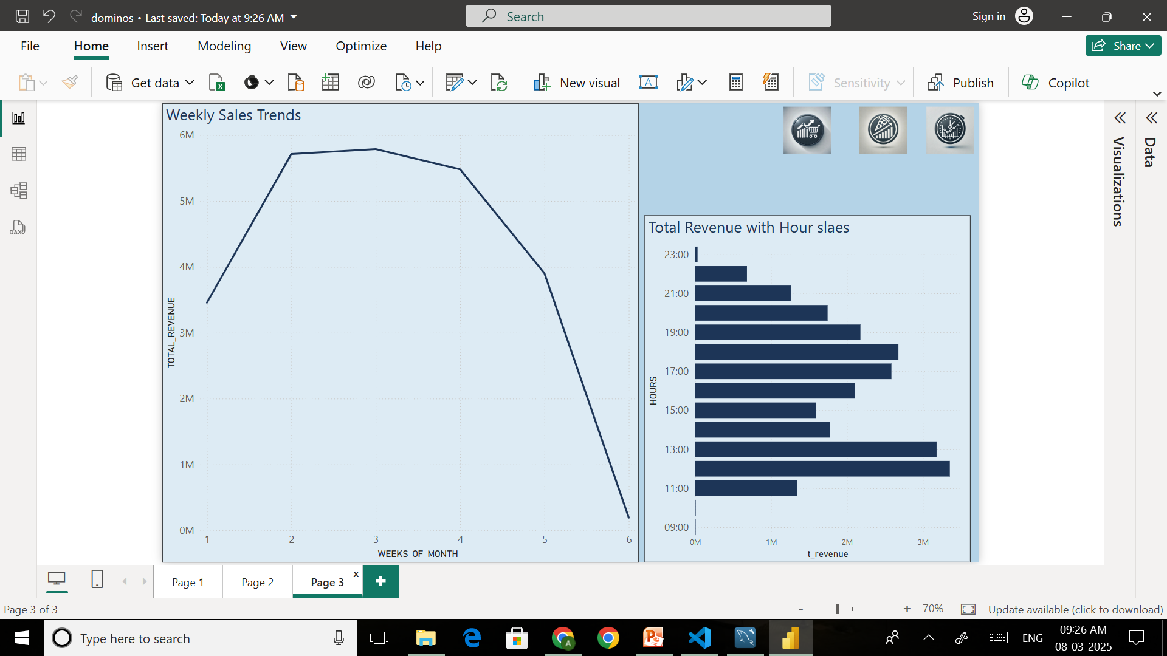
3.Which Week of Month had highest Sales?(Weekly Sales Trend)
INSIGHTS: In weeks of all months week no. 3 had highest sales which is 5786345( 5.79M).

Slide 10
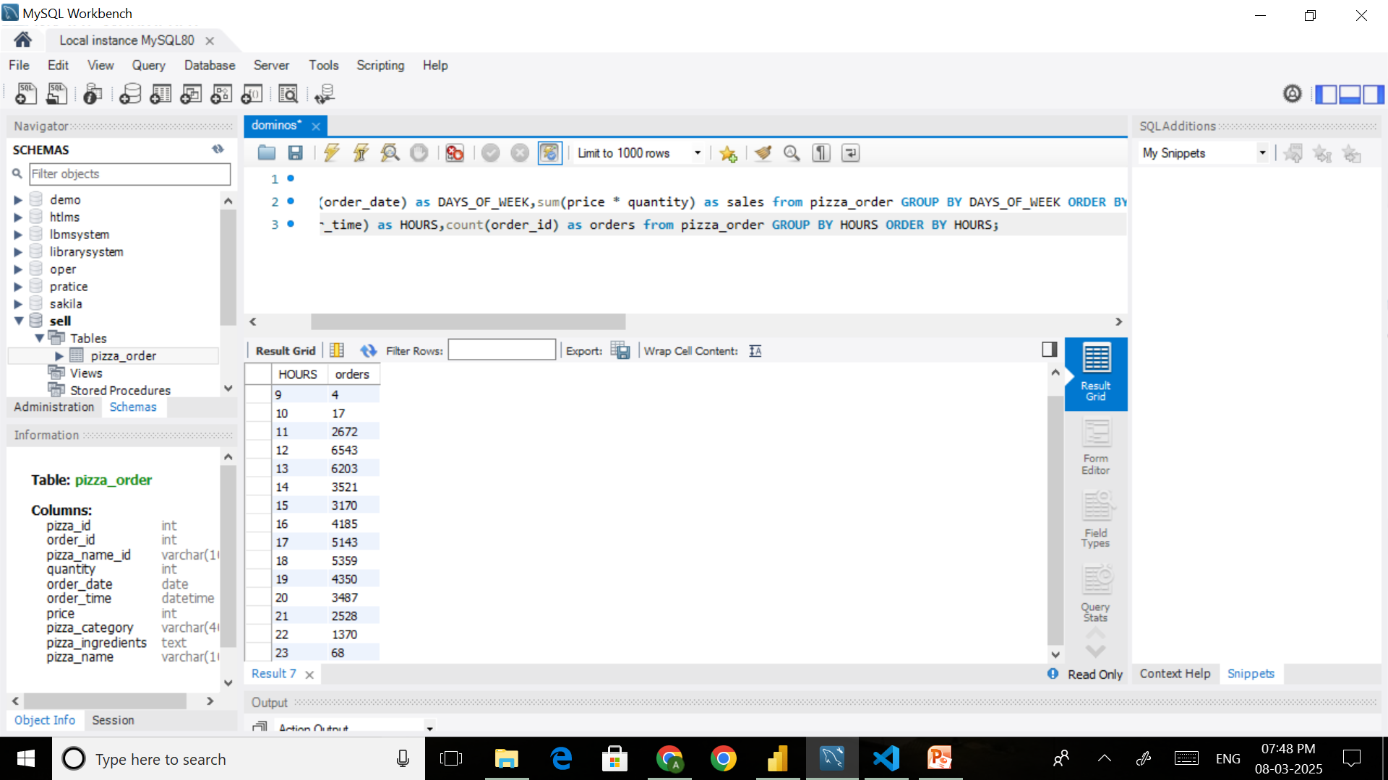
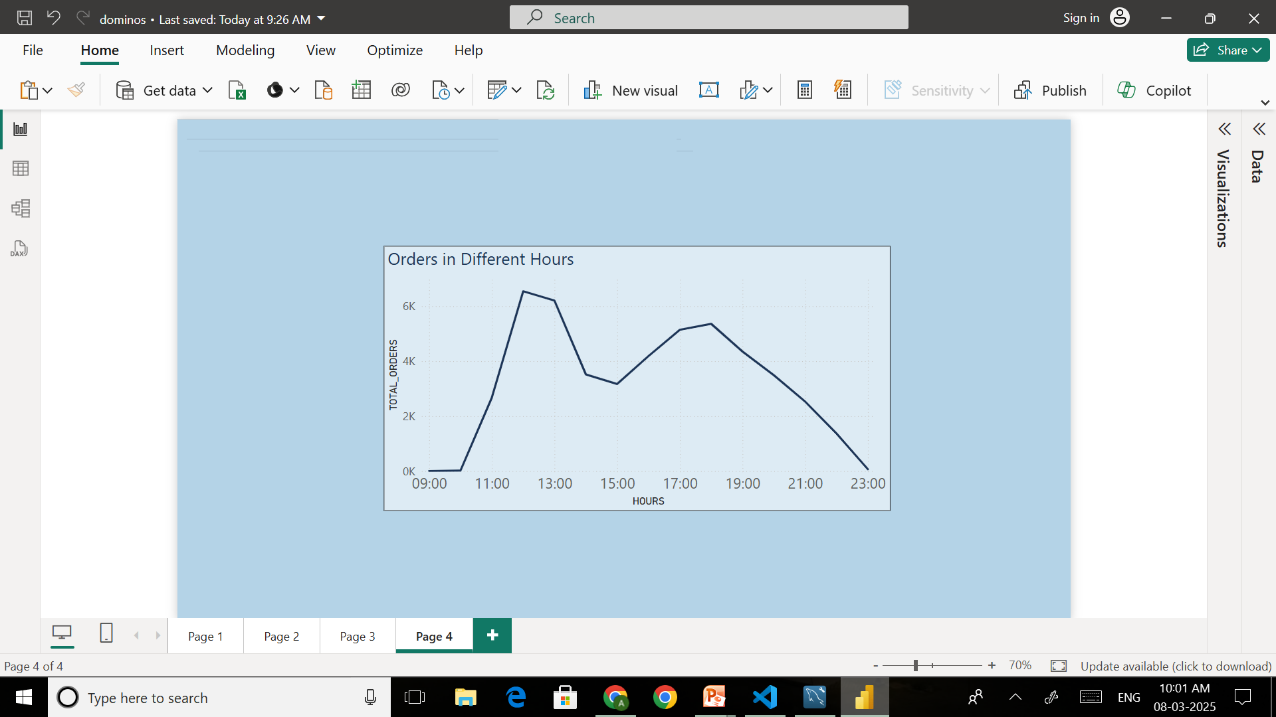
4.What is peak order time during the day?
INSIGHTS : In our total orders we have get highest 6543
Orders at 12 Hour. Our sales Peak Hour of Orders is 12 AM.

Slide 11
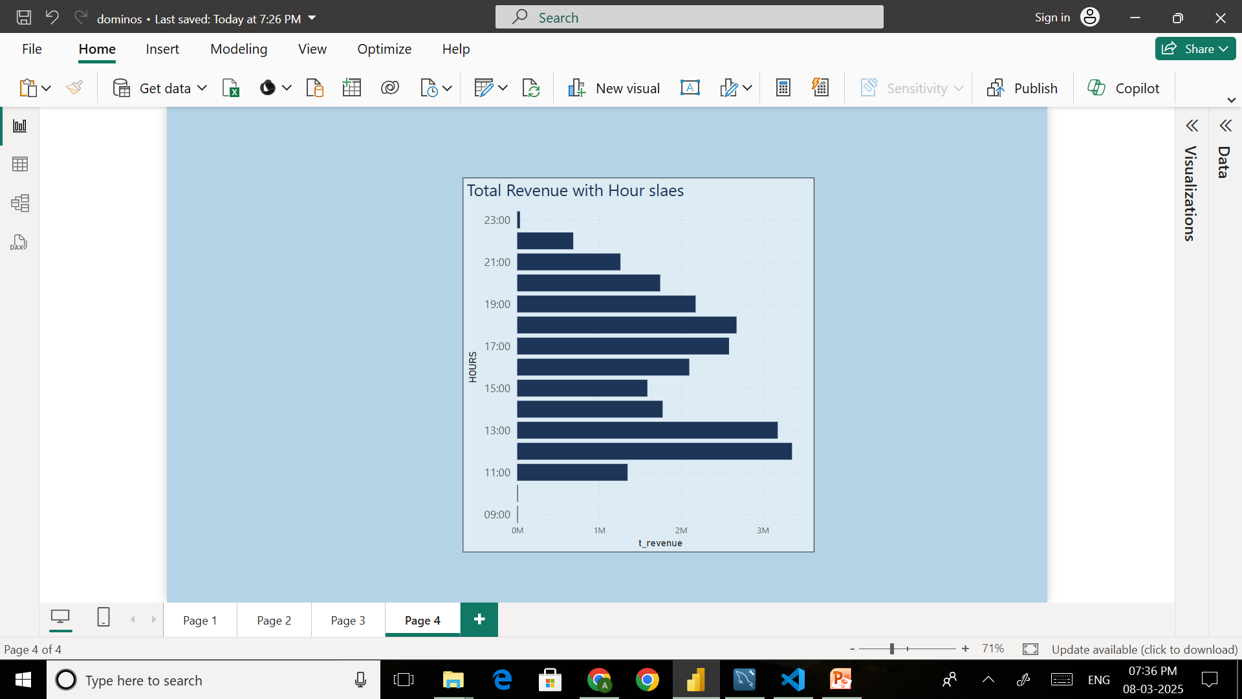
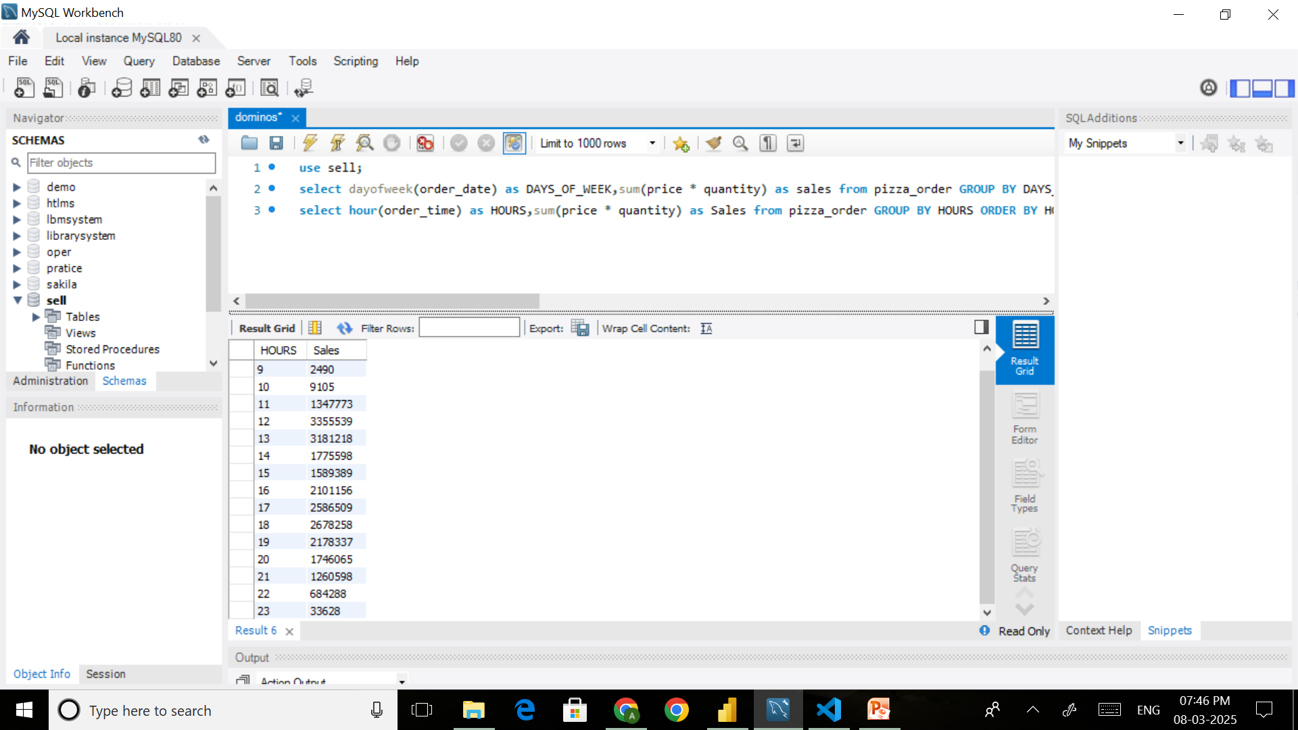
5.What is the Distribution of orders across different Hours of Day?
INSIGHTS : We have generate highest sales at 12 Hour which is 3355539
or also at 13 Hour which is 3181218.

Slide 12
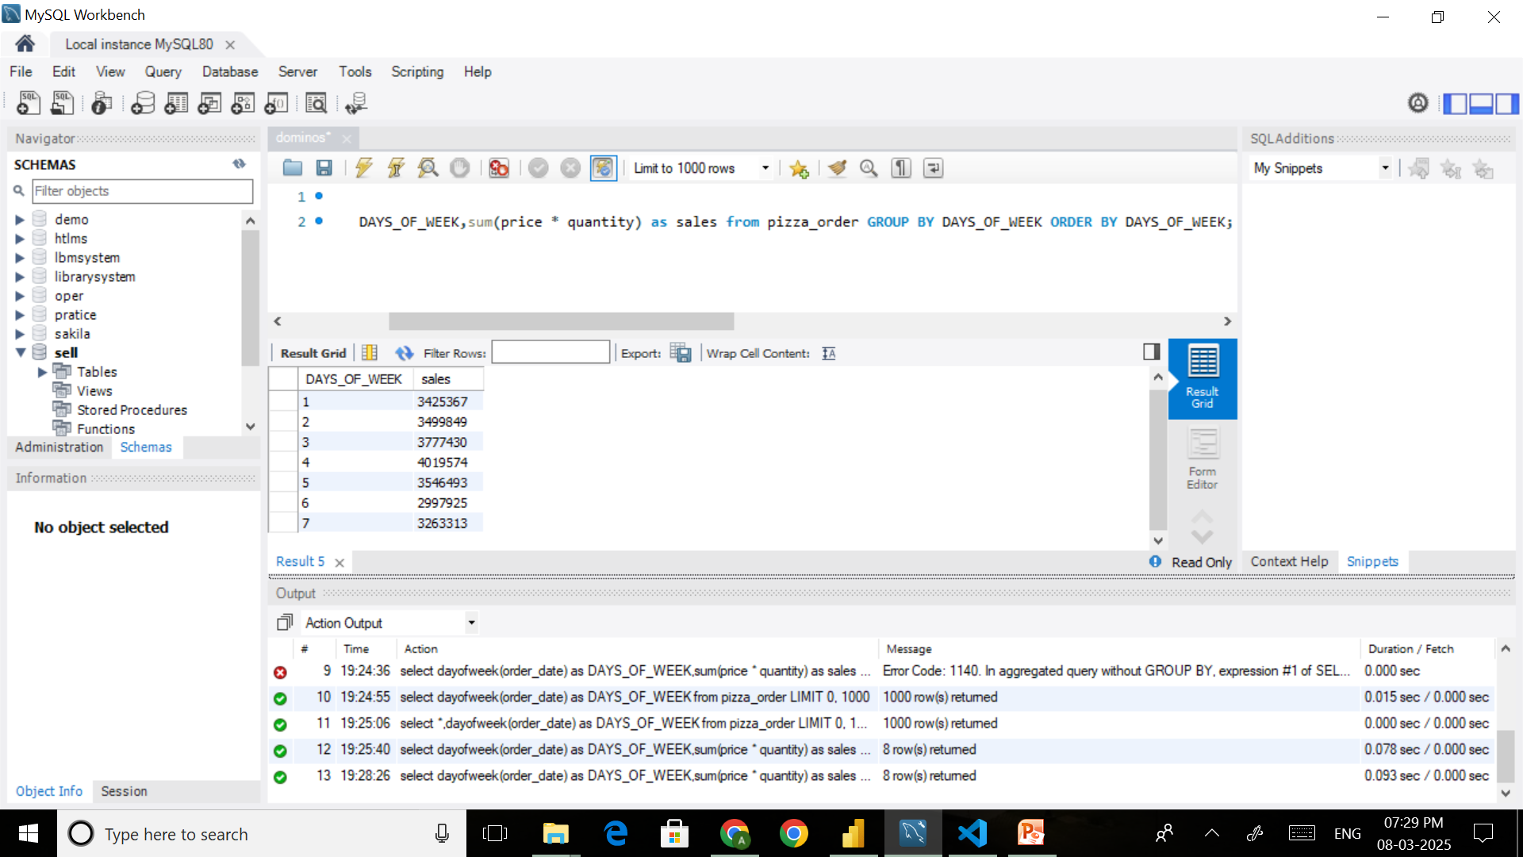
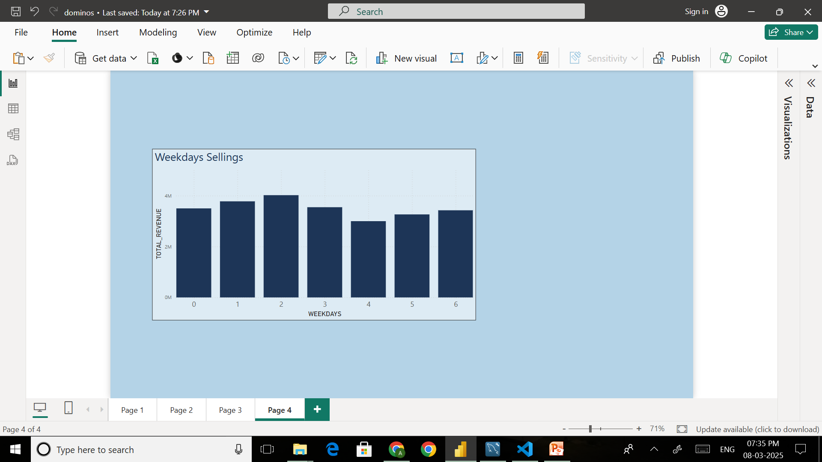
6. Which days of week has Highest Sales and Lowest Sales?
INSIGHTS : we have compare sales of all days of week in which Day No. 4 had highest sales of 4019574 and Day No. 6 had lowest Sales of 2997925.

Slide 13
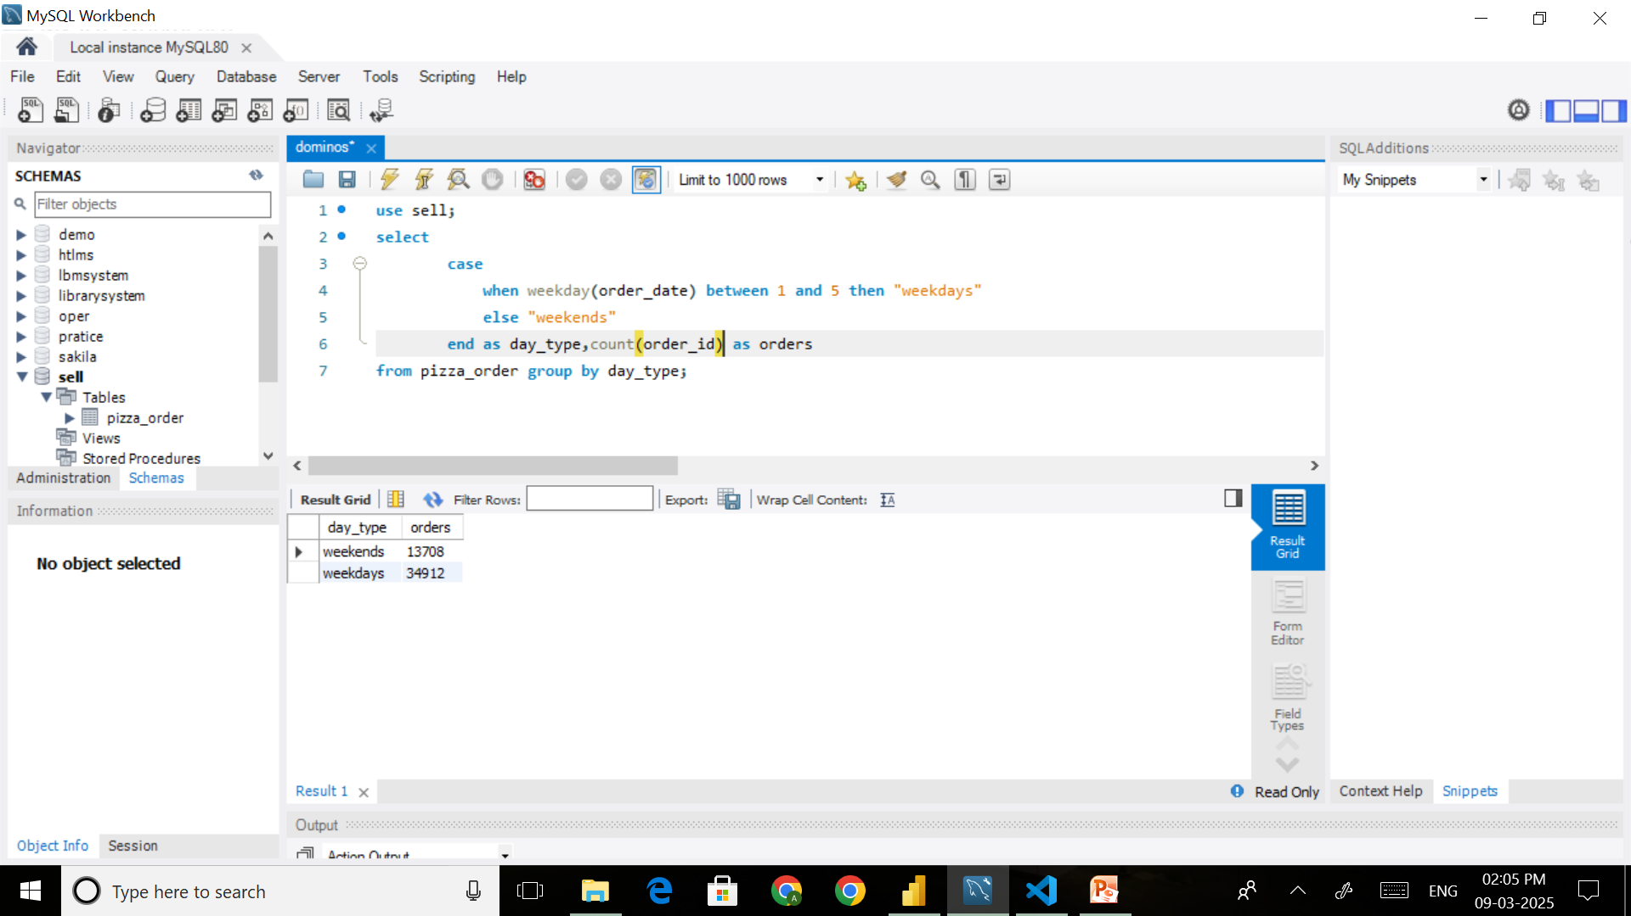
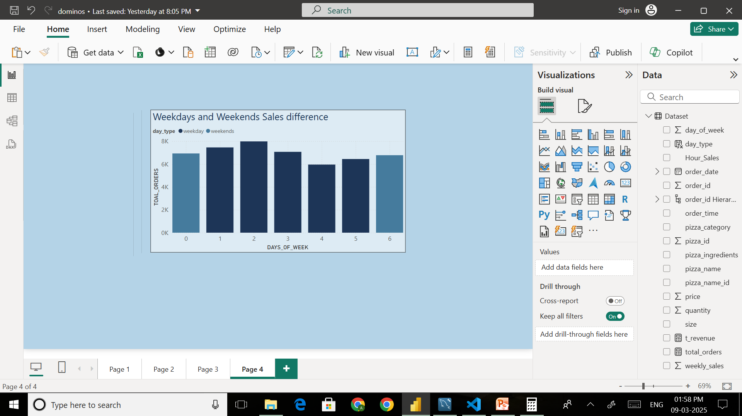
7.Are any Seasonal trends in pizza sales?(weekdays or weekends)
INSIGHTS : As we have see above here in normal Weekdays Orders(34912)
are higher than weekends Orders(13708).

Slide 14
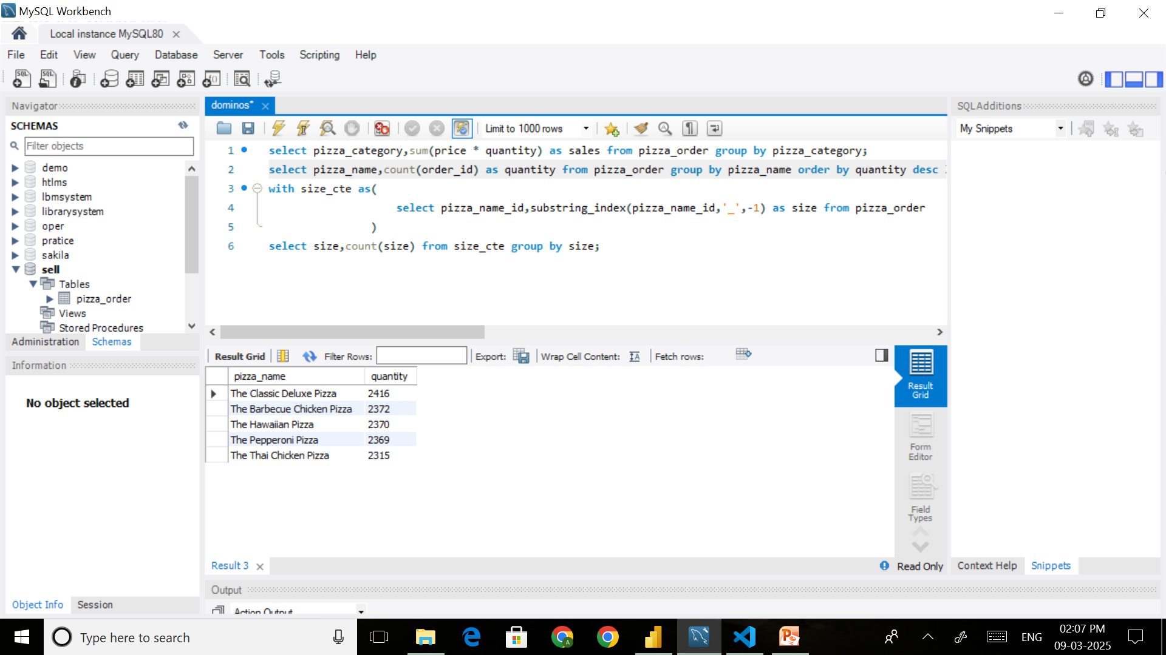
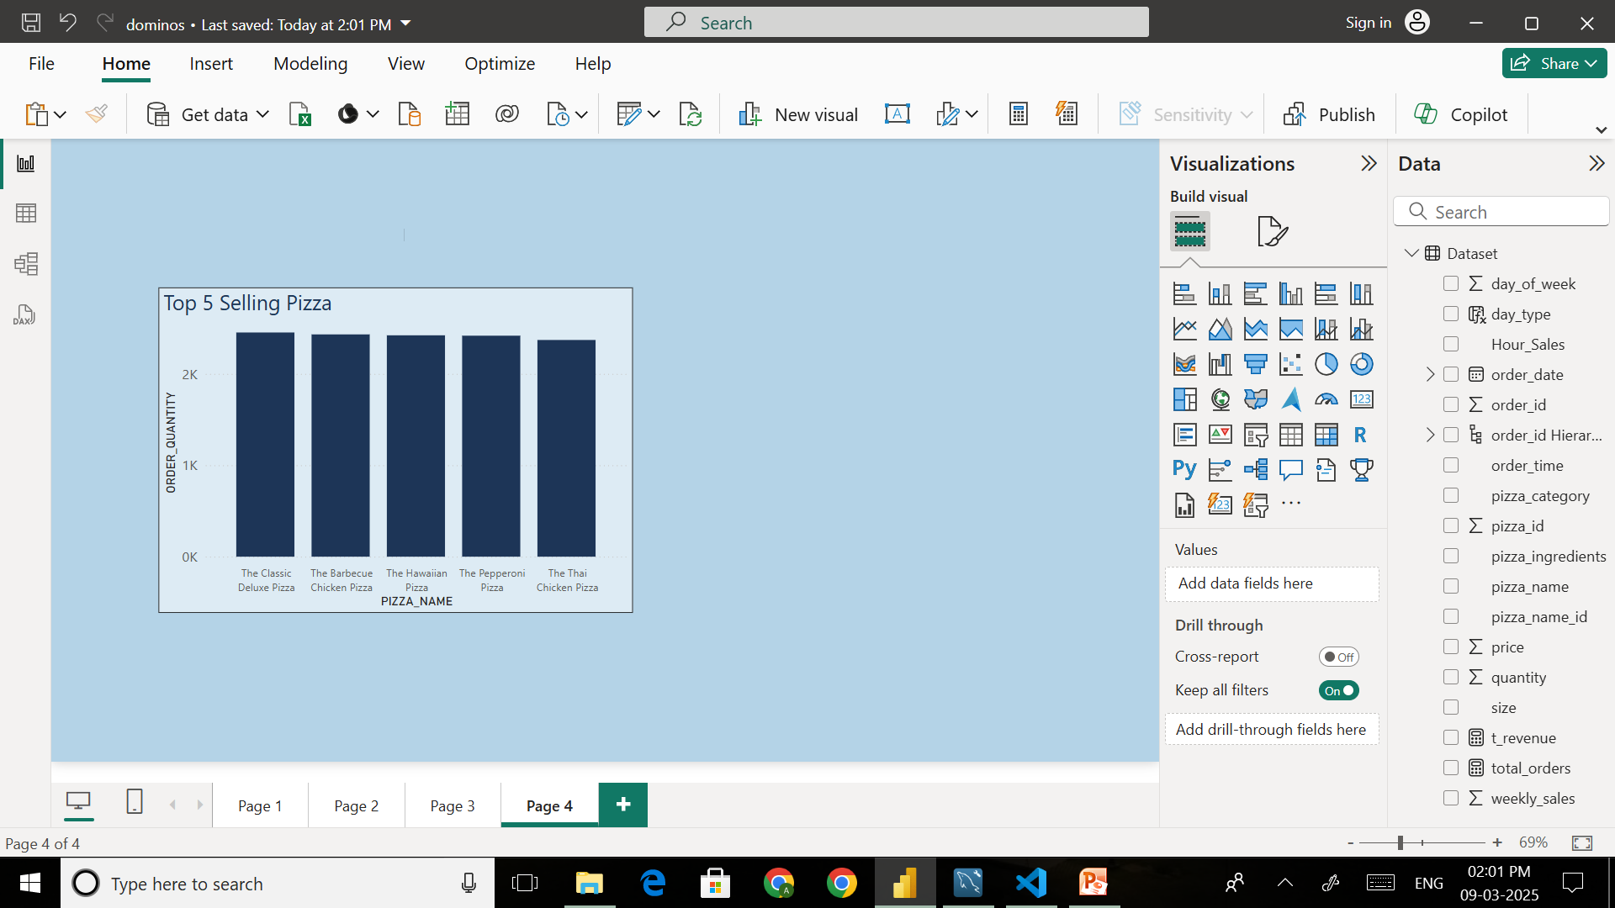
8. What are top 5 best-selling pizzas based on orders?
INSIGHTS : As above We have get our Top 5 most selling Pizzas with their names from our all Orders.

Slide 15
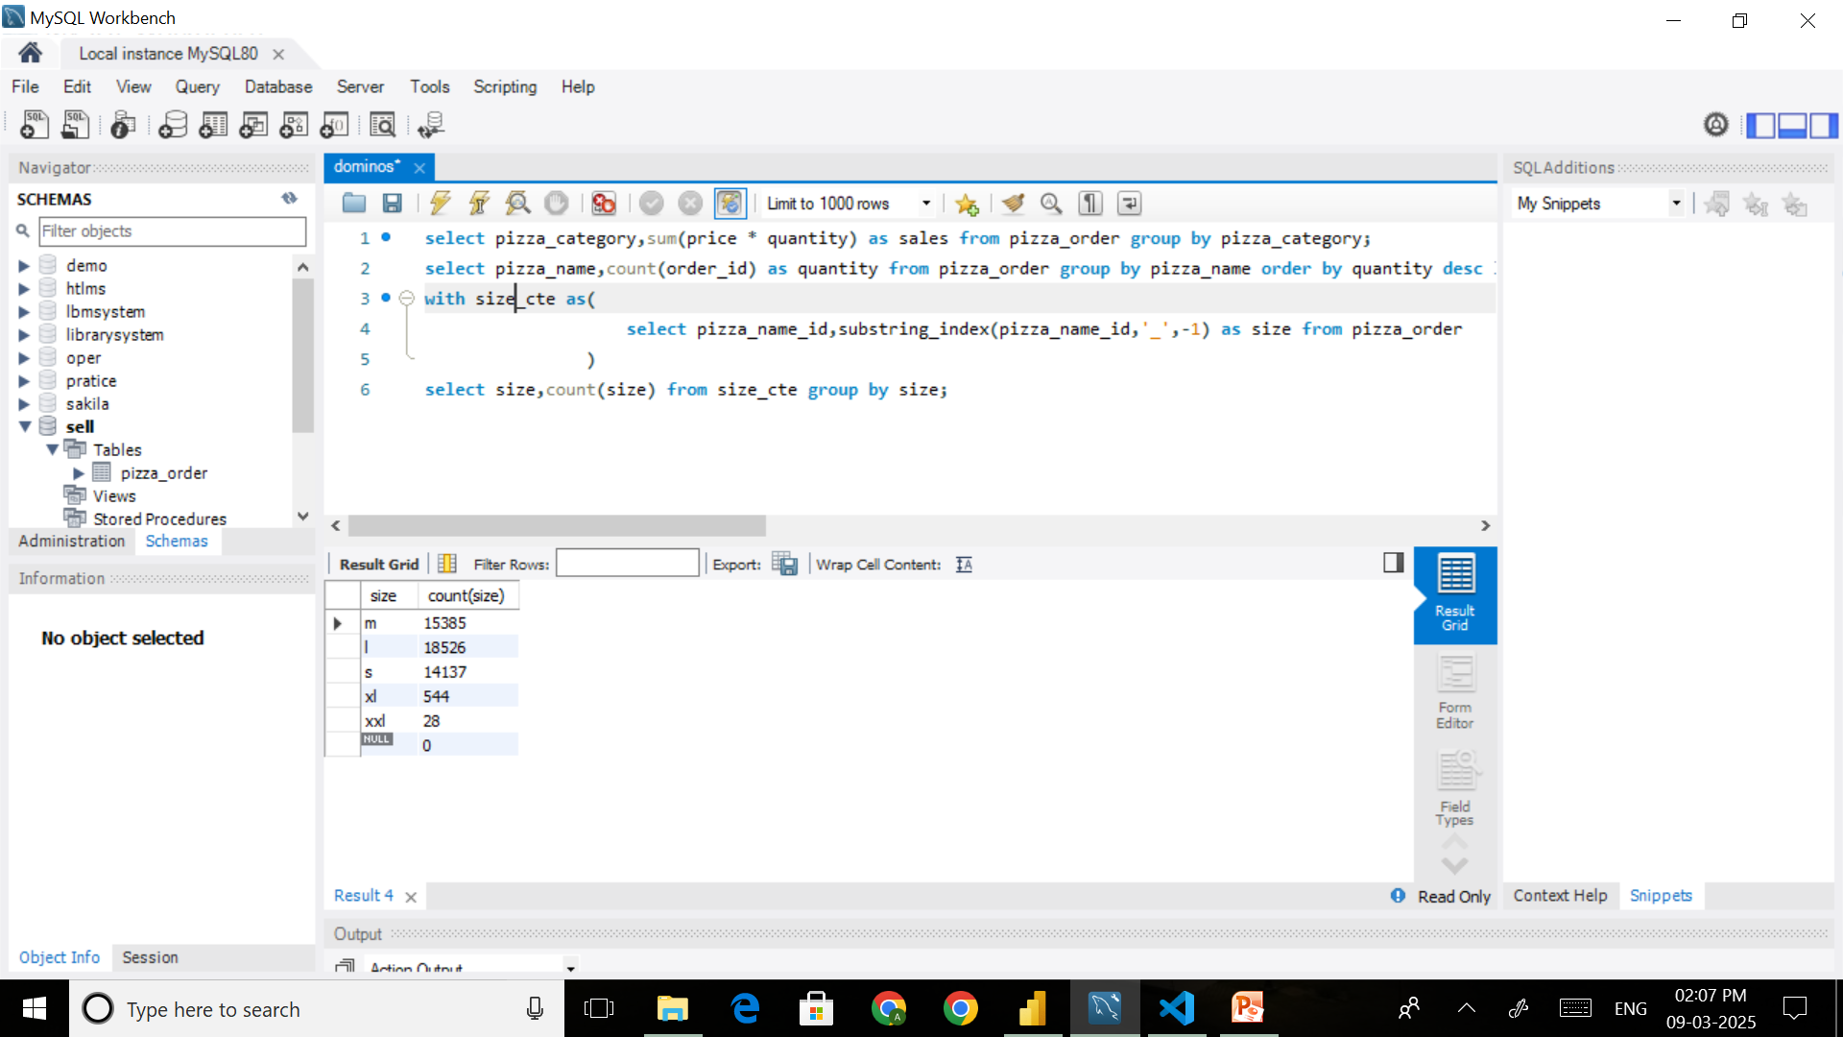
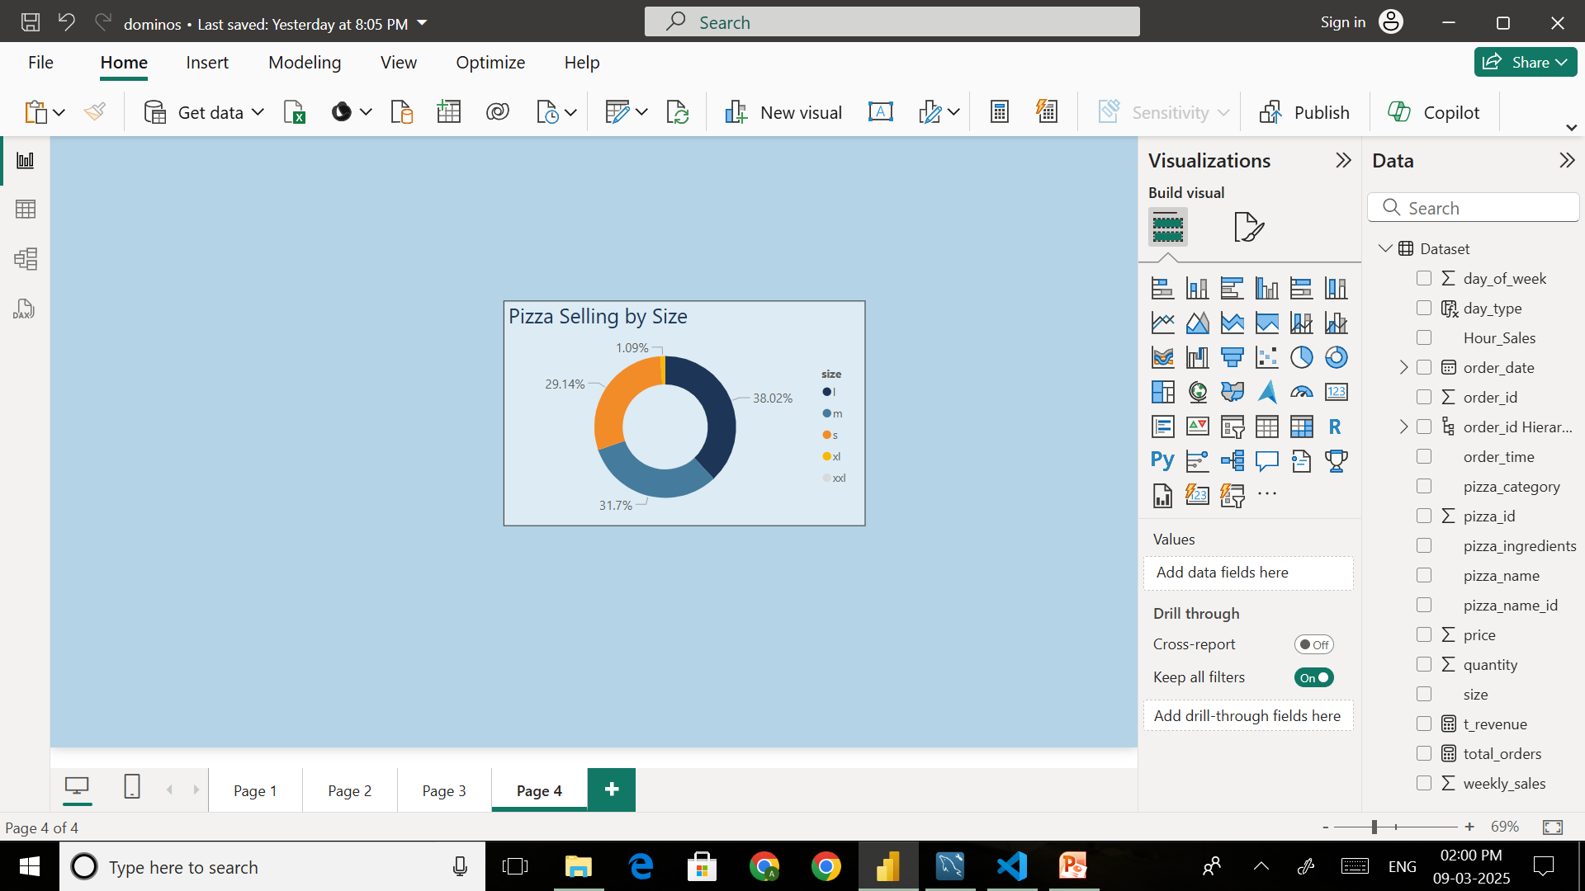
9.Which size of Pizza had most ordered?
INSIGHTS : In our selling size of M pizza are more ordered around 15385
OR XXL size pizza are ordered few around only 28

Slide 16
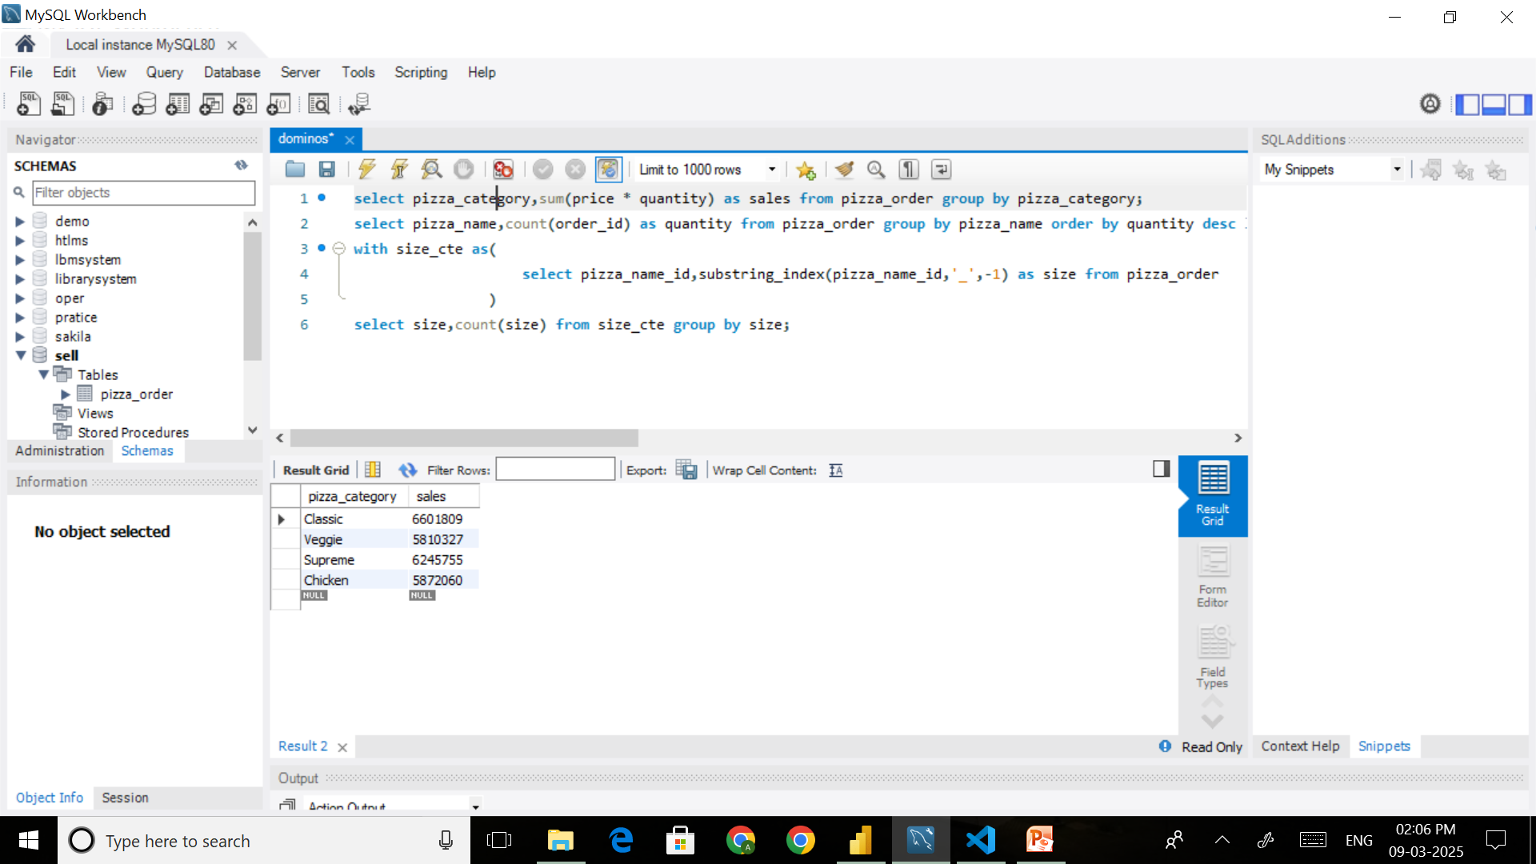
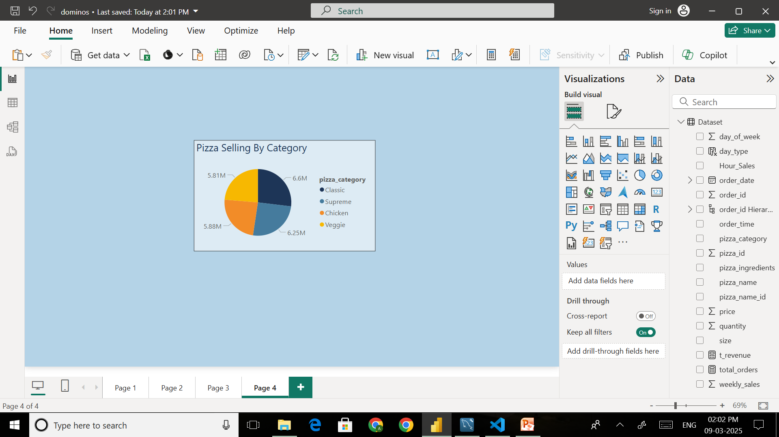
10.Which Pizza Category generates the most Revenue?
INSIGHTS : In our all selling classic pizza which generate revenue of 6.6M in total revenue.
and supreme pizza generate revenue around 6.25M.

Slide 17
Thank You

